Slide 1
HEALTH & PHYSICAL ACTIVITY prediction
Powered by artificial intelligence

Slide 2




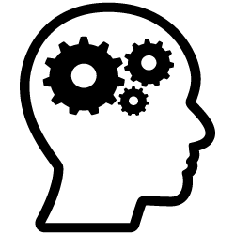
INTRODUCTION
Most of people in the world living a sedentary lifestyle and many of our jobs have become more inactive with long hours sitting at a desk.
Inactive lifestyle is the major causes of numerous health problems and it increases the risk of cardiovascular diseases.
According to WHO Cardiovascular Diseases (CVD) are the number 1 cause of death globally and 17.9 million people die each year, an estimated 31% of all deaths worldwide.
Artificial Intelligence have a potential in many aspects of health care tasks.
Using machine learning algorithm person’s health data can be used to predict the risk of heart disease.

Slide 3




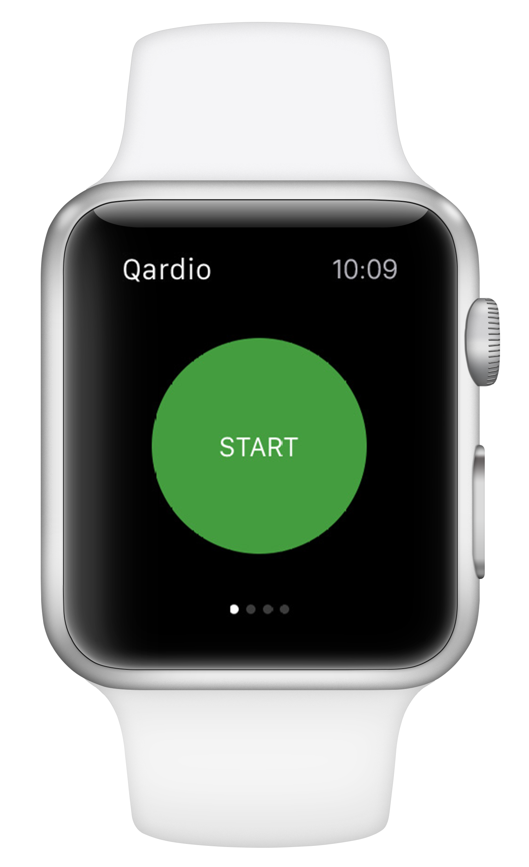

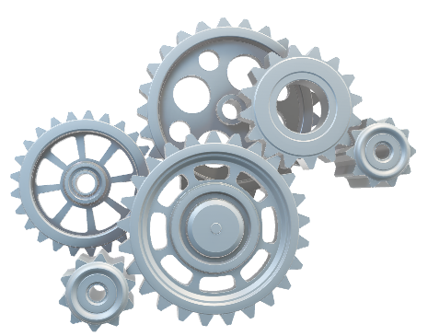

High level flow
MACHINE LEARNING ALGORITHM
ONLINE HEALTH
ASSESSMENT AND FORM SUBMISSION
MEDICAL HEALTH
RECORDS
HEALTH PREDICTION
PHYSCICAL ACTIVITY DATA
ACTIVITY TRACKERS
MACHINE LEARNING ALGORITHM
ACTIVITIES AND GOALS PREDICTION

Slide 4






PREDICTION FLOW
CLEAN AND PREPARE
DATA
MEDICAL RECORDS
TRAINING SET
TEST SET
TRAIN
TEST MODEL
LEARN MODEL
MACHINE LEARNING ALGORITHM
MODEL
PREDICTION

